Slide 1
Ubuntu
and basic Linux command part 1
Nguyen Quang Khai
19/05/2024

Slide 2
Contents
1. Introduction: Ubuntu, file systems, some terms.
2. Some basic Linux commands work with files and directories.
- Change working directory.
- List content.
- Create.
- Remove.
- Copy.
- Move.

Slide 3
Introduction

Slide 4




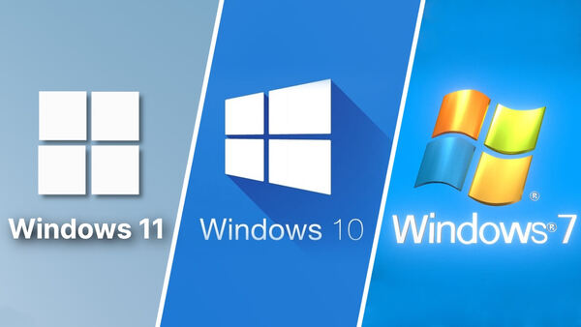
Some popular Operating Systems

Slide 5





Distributions of linux (OS)
Ubuntu OS has the most users

Slide 6
Why linux in bioinformatics?
Linux is an open-source operating system.
- Allows users to customize their systems according to their specific needs.
- It is free.
Linux is the most commonly used operating system in High-Performance Computing (HPC). HPC unlocks primary challenges in bioinformatics:
- Data processing limits.
- Slow analysis times.
- Impact on research progress.
Most bioinformatics tools and applications are designed to be run on Linux-based operating systems.

Slide 7
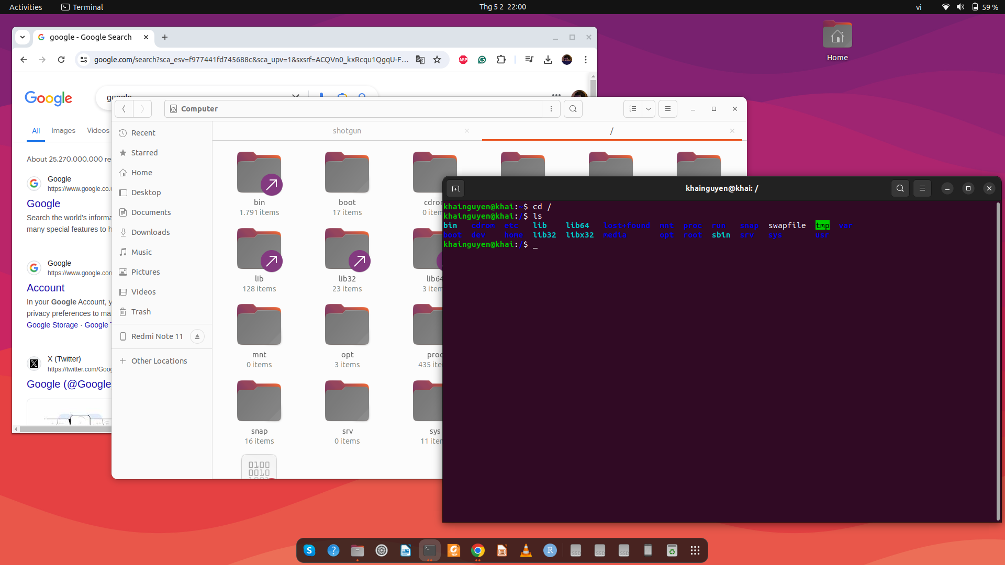
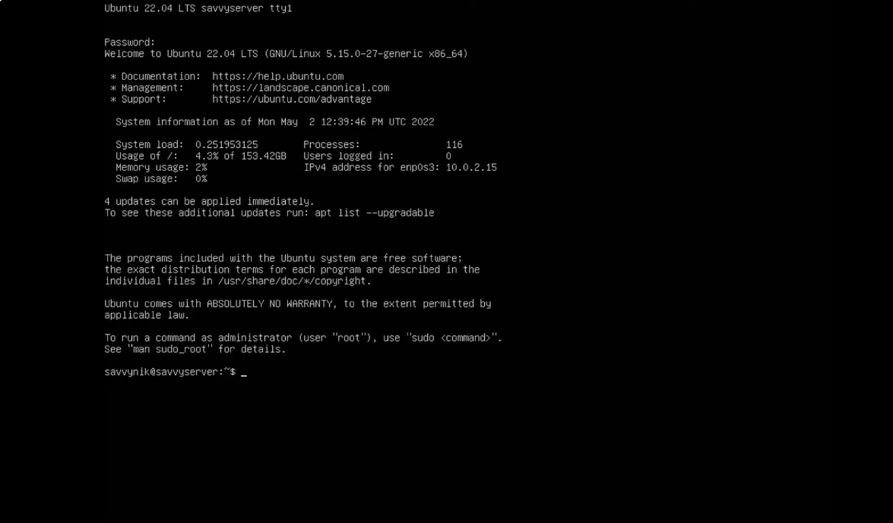
interact with the software/package
graphic user interface - GUI
(mouse + keyboard)
also called
command line interface - CLI
(keyboard)
Ubuntu desktop: GUI + CLI
Ubuntu server: only CLI

Slide 8
Terminal
Terminal window
is where you type commands
Open:
Ctrl + Alt + T keys on the keyboard
Ubuntu desktop

Slide 9
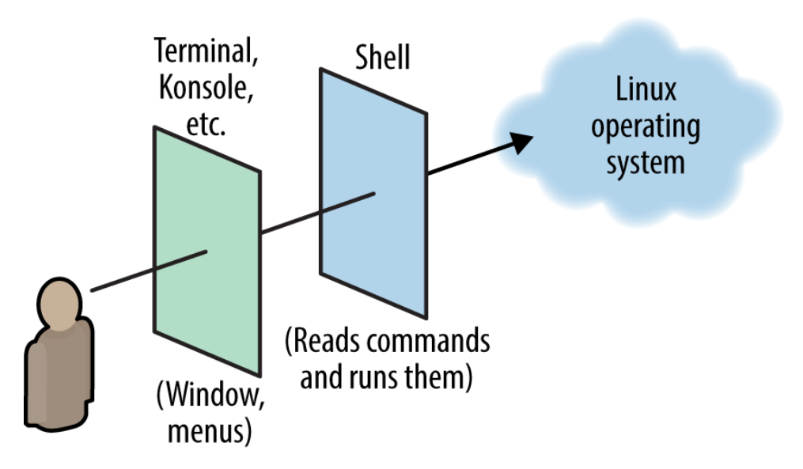

What is Shell?
- A shell is a special user program that provides an interface for the user to use operating system services.
- Terminal is where we interact with the shell through commands.
- Several types of Shell:
+Bourne Shell (sh)
+ C Shell (csh)
+Bourne Again Shell (bash): most popular
+ Z Shell (zsh)
(Daniel J. Barrett, Linux pocket guide)

Slide 10
Some ways to get the Terminal
easy to install
1.
macOS: How to open Terminal:
https://support.apple.com/en-vn/guide/terminal/apd5265185d-f365-44cb-8b09-71a064a42125/mac
Windows 10/11: Install Ubuntu on Windows Subsystem for Linux (WSL): Recommended for beginners
https://canonical-ubuntu-wsl.readthedocs-hosted.com/en/latest/guides/install-ubuntu-wsl2/
2. Install Ubuntu on virtual machine (VM):
Windows: Install Ubuntu on VirtualBox: https://www.youtube.com/watch?v=ngJQPt-xEeo
macOS: Install Ubuntu on VirtualBox: https://www.youtube.com/watch?v=b_tOialCSXE
3. Install Ubuntu on physical computer: Best for long term use
Delete Windows & install Ubuntu: https://www.youtube.com/watch?v=oZcvqfWf_ps&t=100s
If you don't want to delete windows:
or a) Dual boot: Ubuntu and Windows on the same hard drive:
https://www.youtube.com/watch?v=GXxTxBPKecQ&t=229s
or b) Dual boot: Ubuntu and Windows on the separate hard drive:
(Ubuntu on hard drive 1, Windows on hard drive 2)
https://www.youtube.com/watch?v=KX85vZ3ANVk
Recommended method b) if you want dual-boot.
Warning: backup your data before install!!
More reference: https://www.youtube.com/watch?v=oZcvqfWf_ps&t=100s
a bit difficult to install

Slide 11
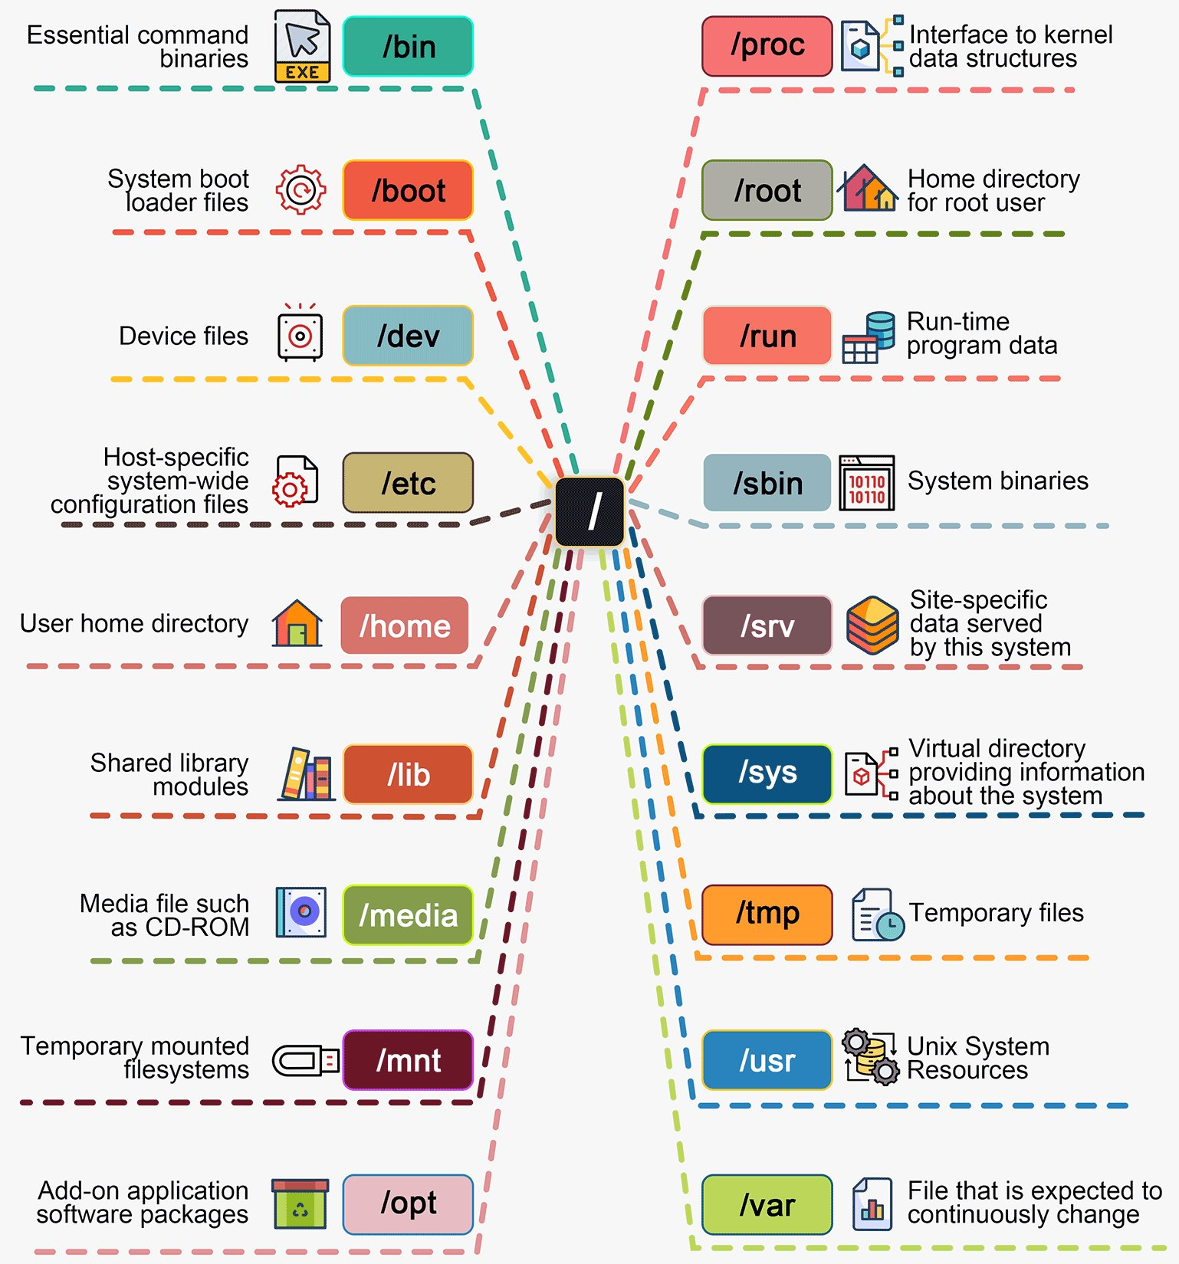
Linux file systems
Root
directory
The root directory is a special directory that contains all of the other files and directories on the computer. The root directory is specified as a / at the beginning of a path
user_name directory (or folder):
/home/khainguyen/
/home/vanA/
/home/vanB/
https://x.com/bytebytego/status/1764911444993495121

Slide 12
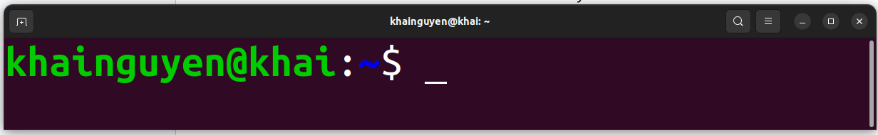
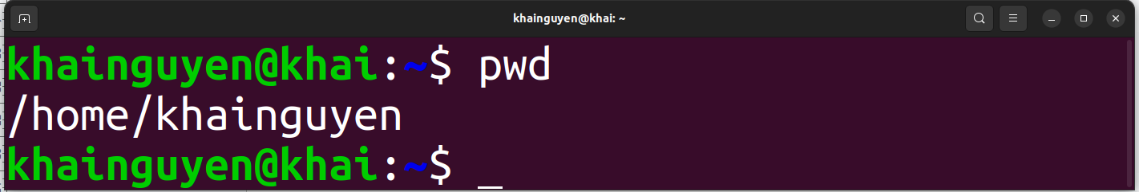

When opening the terminal, default:
$ means non-root user
tell you the computer is ready to accept a command
command
prompt
cursor
user_name
host name
The tilde ( ~ ) represents the home directory of the currently logged in ‘user_name’
This case, user_name is khainguyen, so the path is: /home/khainguyen
ENTER
To print the current path, type the command: pwd
,then hitting the ENTER key on keyboard to run the command
stands for ‘print working directory’

Slide 13
A basic command, could be:
Example: ls command
The command line will be read from left to right by the shell once press ENTER
command
(must have)
a space
option/flag
(optional)
hyphen-prefixed characters
a space
parameter
(optional)

Slide 14
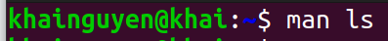
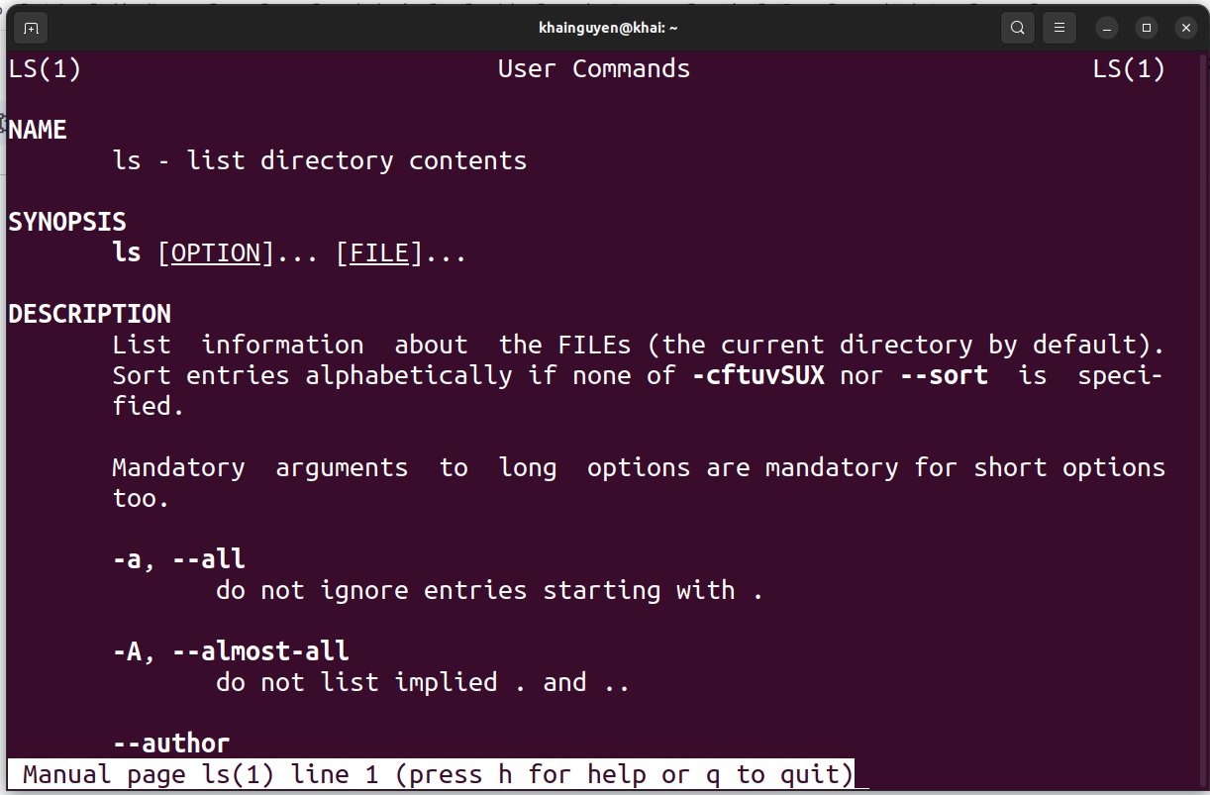
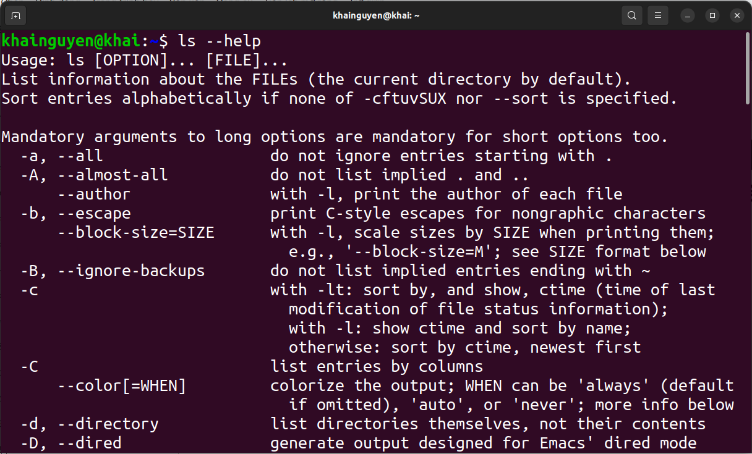
How do I know what options a command has?
man command_name
command_name --help
Example: ls command
Press q key on keyboard to exit

Slide 15
2. Some basic Linux commands work with files and directories

Slide 16
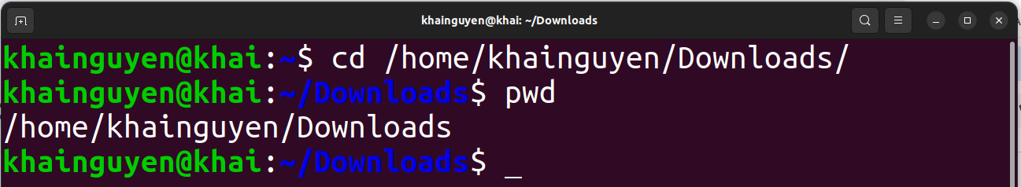
change working directory
cd command, an abbreviation for ‘change directory’.

Slide 17
Path shortcuts
~ the home directory of the currently logged in ‘user_name’
/ the root directory
. the current directory (or the working directory)
.. the parent directory of the working directory
../.. the parent directory of the parent directory of the working directory

Slide 18
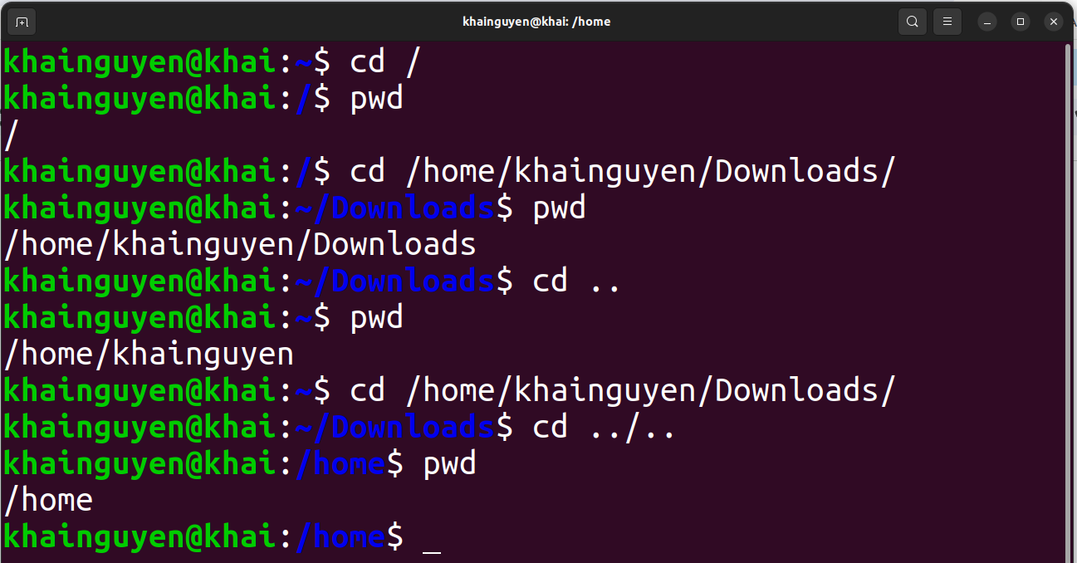
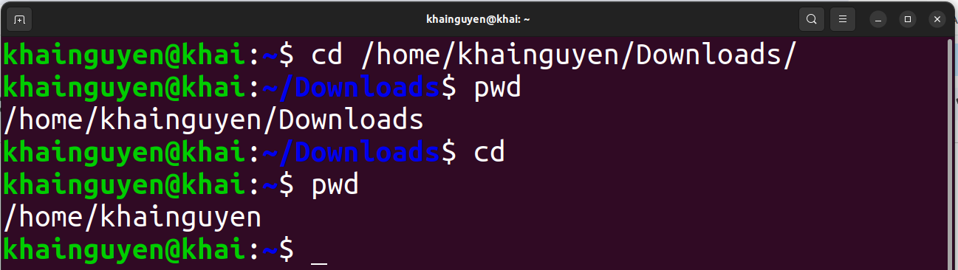
just cd to change to ~

Slide 19
Absolute path: from the root directory to the interest directory/file.
Relative path: from the working directory to the interest directory/file.
Absolute path
Relative path

Slide 20
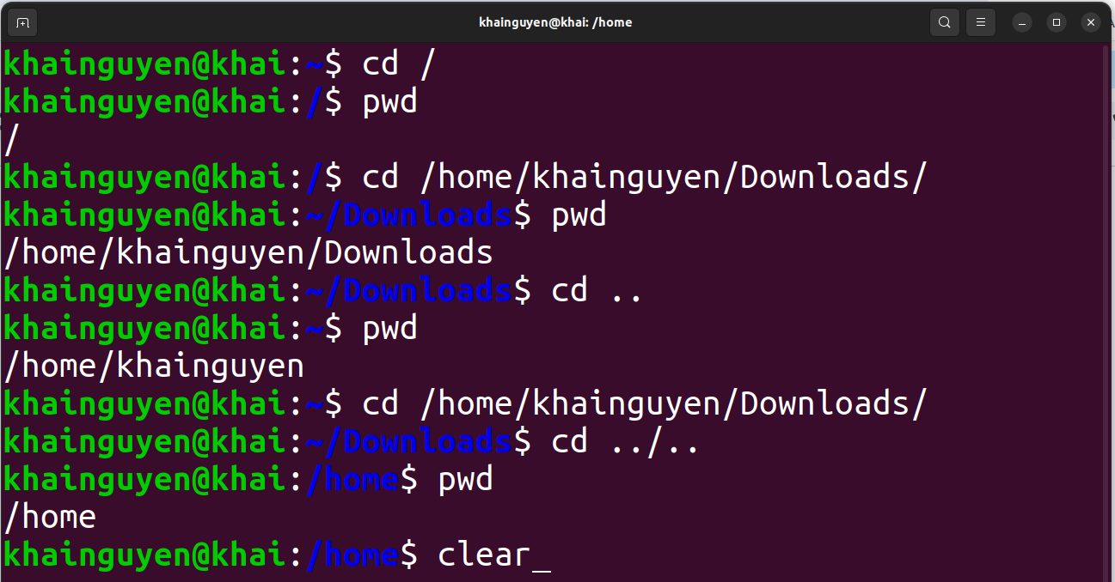
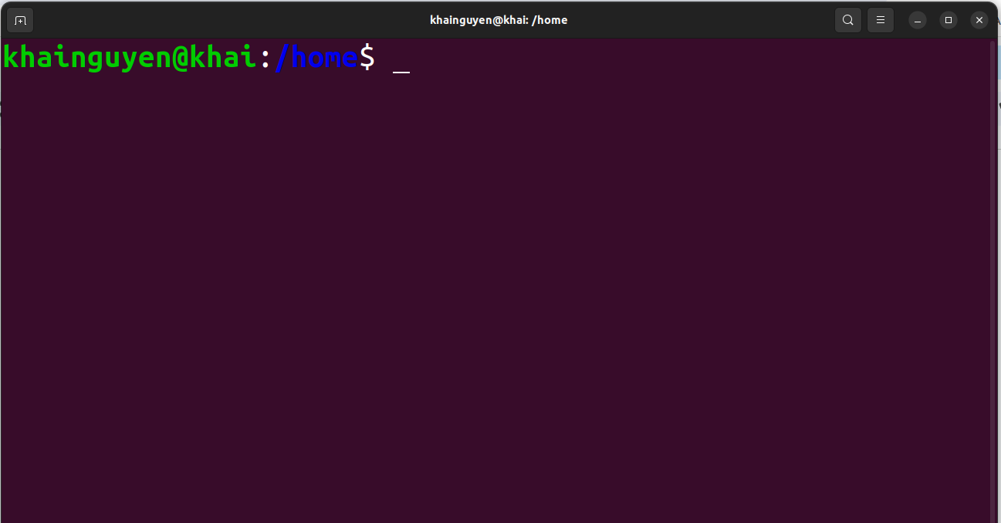
Clean up all the command lines and results above, with command: clear
ENTER
or using: Ctrl-L

Slide 21
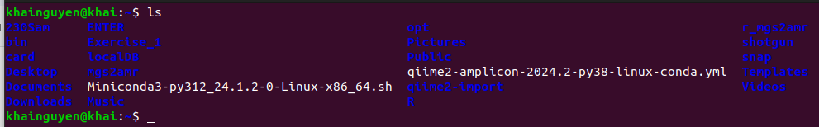
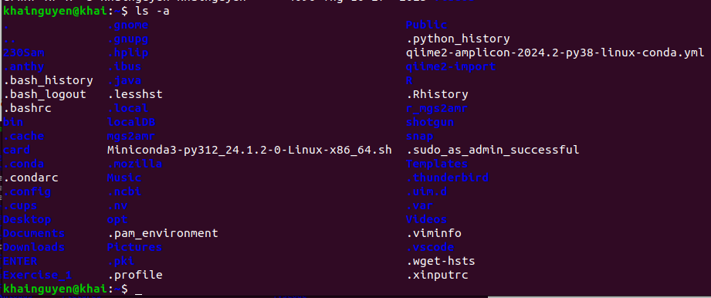
Listing content (files and subdirectories) of a directory
with command: ls (“ls" stands for “list”)
list files and directories in current directory (in short format):
ls
list all files and directories in current directory (in short format):
ls -a
or
ls --all
ls --help

Slide 22
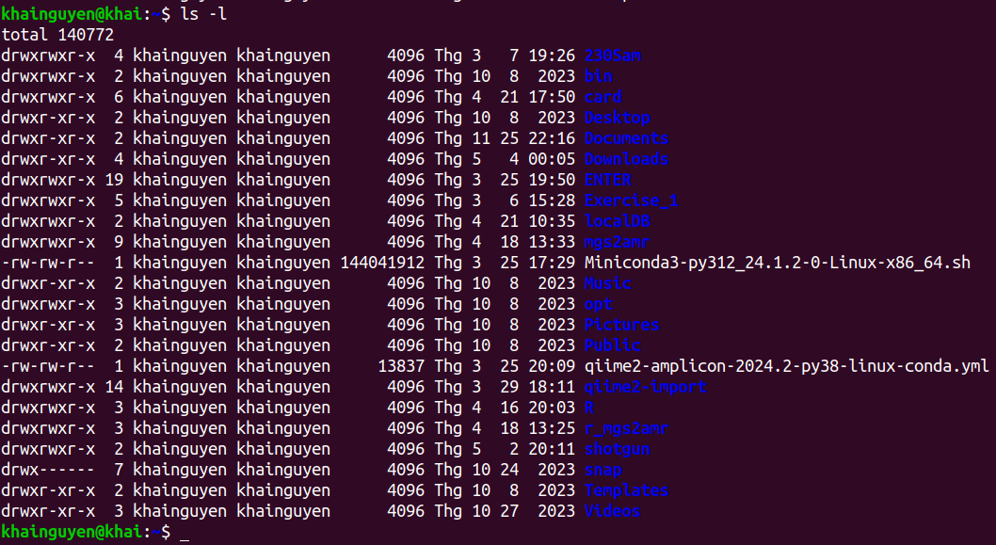
list files and directories in current directory (in long format):
ls -l
ls --help

Slide 23
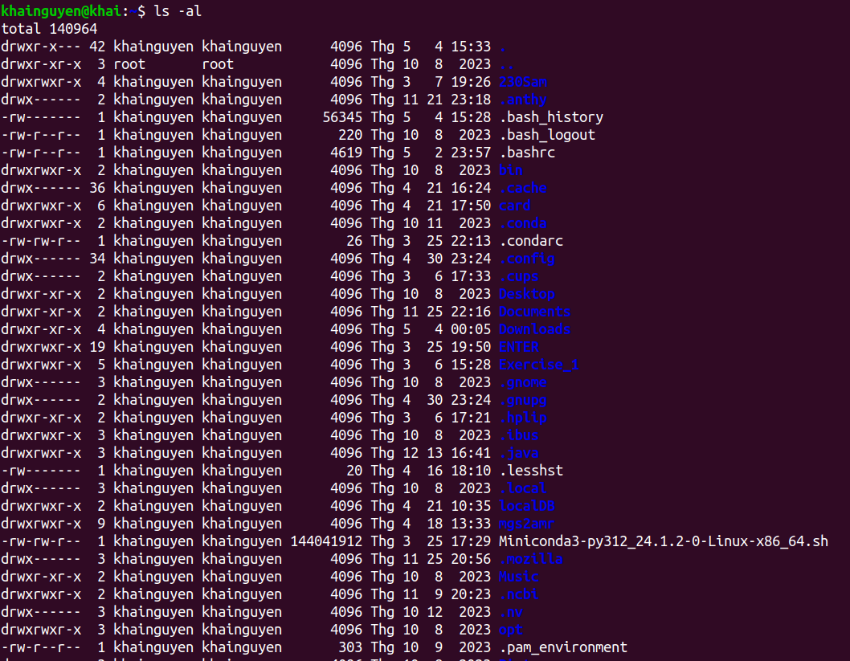
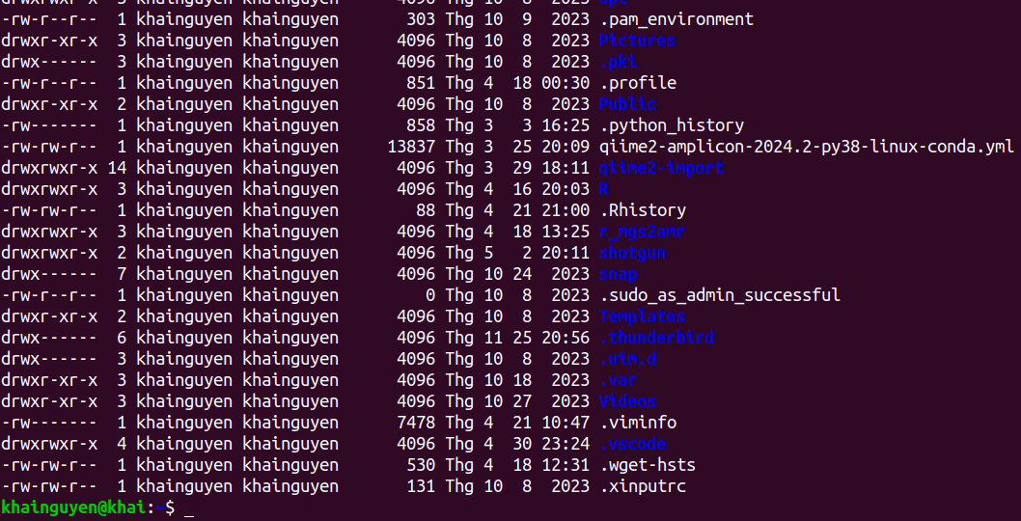
list all files and directories in current directory (in long format):
ls -al

Slide 24
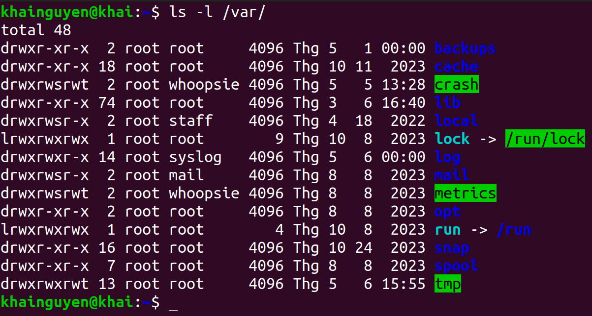
list files and directories in another directory (in long format):
ls -l path_to_directory

Slide 25
File type:
“d” means this is a directory
Permissions
Owner of file
(user_name)
user group
size
(in bytes)
Last modification time
directory/file name
number of hard links

Slide 26
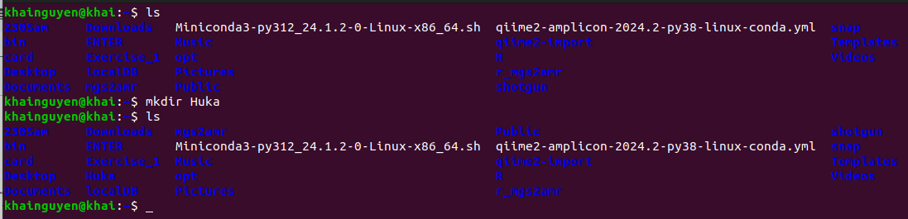
Create and remove directory
Create a directory named “Huka” in the current directory (~) , with the command: mkdir
mkdir Huka
or
mkdir ./Huka
“mkdir” stands for “make directory”
Run “ls" to check
a new directory is created

Slide 27
Create and remove directory
Create three directory named “Huki”, “Huka", “Huke" in the current directory
mkdir Huki Huka Huke
Delete a empty directory named “Huka” in current directory, with command: rmdir
rmdir Huka
“rmdir” stands for “remove directory”
Delete a non-empty directory named “Huka” in current directory, with the command “rm”, option -r:
rm -r Huka
or
rm -R Huka
or
rm --recursive Huka/
“rm” stands for “remove”
rm --help

Slide 28
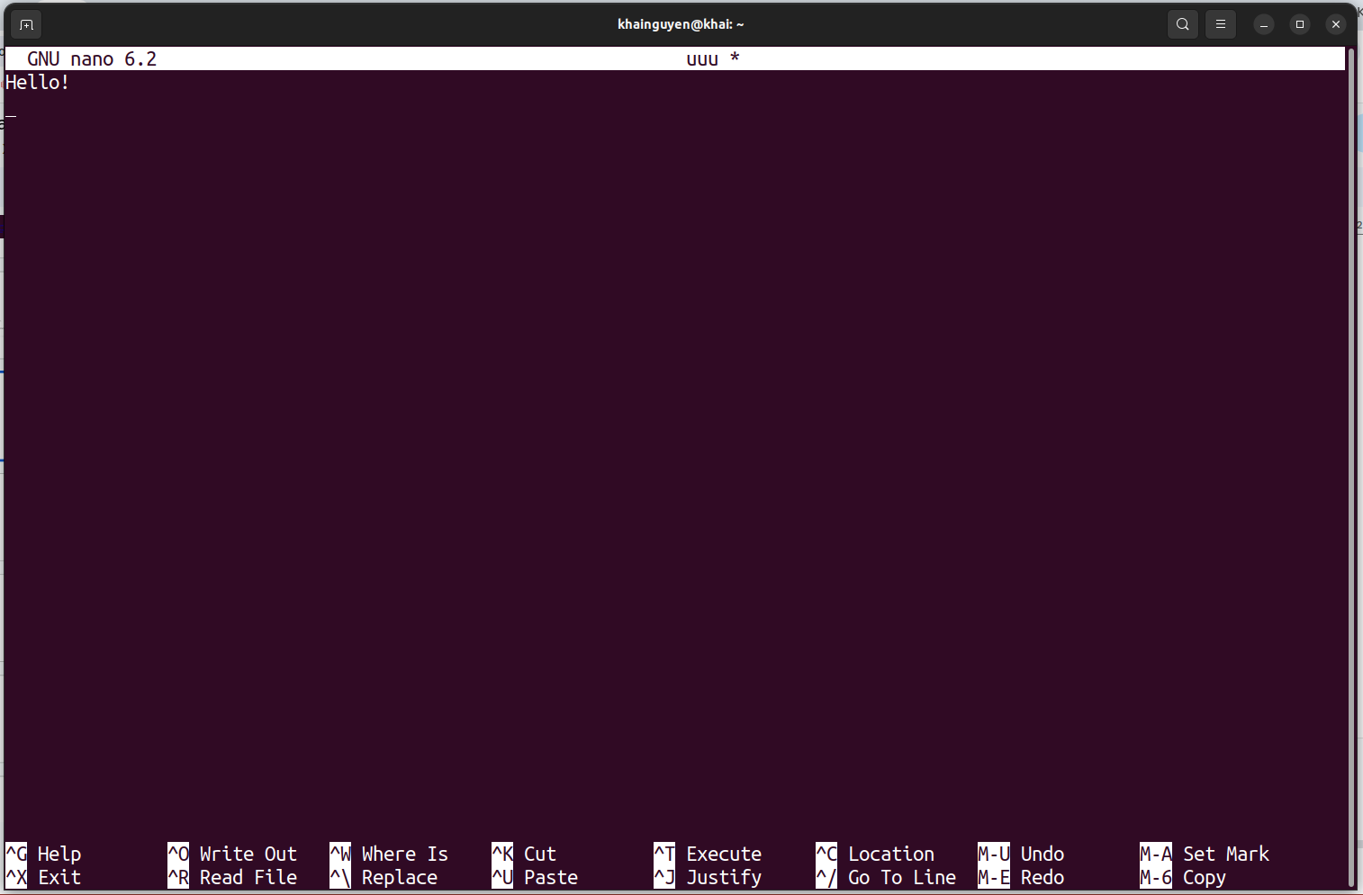
Create and remove file
Create and edit text file with nano, a text editor
1. Create a text file named “uuu" (“uuu” doesn't exist):
nano
or
nano uuu

Slide 29
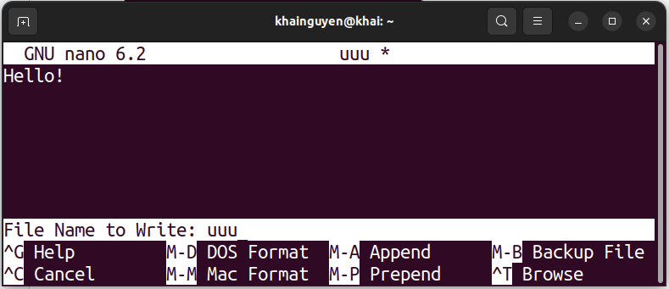
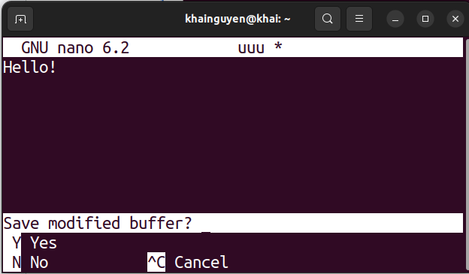
2. Exit nano: ctrl + x
3. Type “y" to save:
Edit the file name if you don't want the name "uuu"
4. Finish: press ENTER key
We can view the file “uuu" with nano by run (if the file exist in current directory):
nano uuu
Create a empty file named “uuu", with “touch” command :
touch uuu
rm uuu
Delete a (empty or non-empty) file named “uuu” in current directory, with the command “rm”:

Slide 30
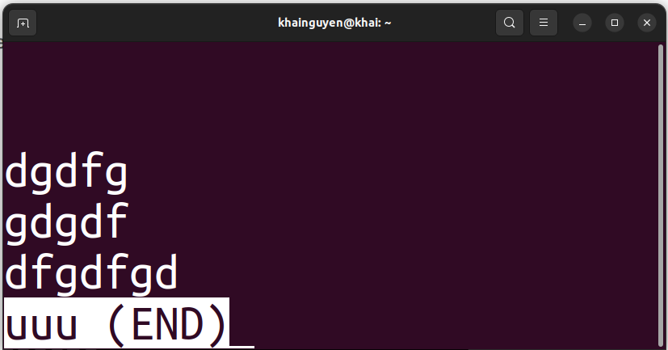
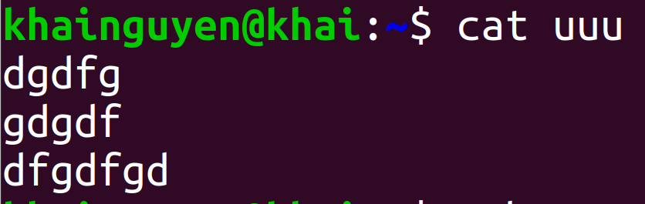
View the file with another commands
View the file with command: less
ENTER
press “q" key to quit
View the file with command: cat

Slide 31
Copy and move file/directory
Copy a file named “uuu” in the current directory to ./Download/, with command: cp
cp ./uuu ./Download/
“cp” stands for “copy”
Copy three the file named “uuu”, “iii", “yyy" in the current directory to./Download/
cp ./uuu ./iii ./yyy ./Download/
or
cp uuu iii yyy ./Download/
or
cp ./{iii,yyy,uuu} ./Downloads/
Create a copy of the file named "uuu" with a different name "ooo" in the current directory
cp ./uuu ./ooo
Copy a empty directory named “Huka” in the current directory to ./Download/
cp ./Huka/ ./Download/
note again: ./ means the current directory

Slide 32
Copy and move file/directory
Copy a non-empty directory named “Huka” in the current directory to ./Download/
cp -r ./Huka/ ./Download/
Move a file named “uuu” in the current directory to /home/khainguyen/Download/, with command: mv
mv ./uuu ./Download/
“mv” stands for “move”
Move a empty directory named “Huka” in the current directory to /home/khainguyen/Download/
mv ./Huka/ ./Downloads/
if Huka/ is a non-empty directory, add -r option:
mv -r ./Huka/ ./Downloads/
Rename a file named “uuu” to “eee":
Rename a directory named “Huka” to “Huko":
mv ./uuu ./eee
mv ./Huka/ ./Huko/

Slide 33
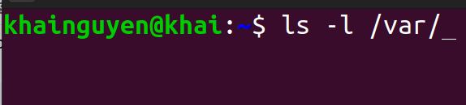
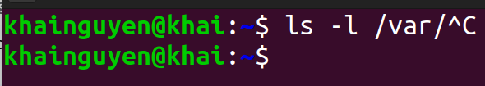
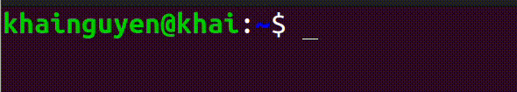
Shortcuts:
∙ Ctrl-C stops the current in-progress command and/or
Ctrl-C
∙ Up arrow key: shows previous commands
∙ history command: will show the history of commands you have run.

Slide 34
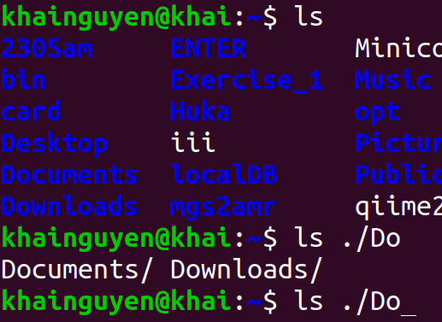
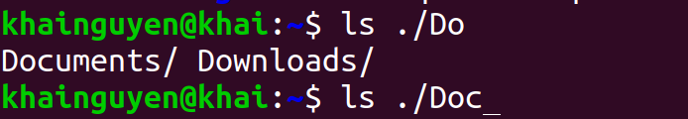
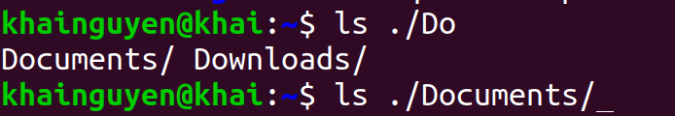
Shortcuts:
∙ Ctrl-A moves the cursor to the beginning of the line.
∙ Ctrl-E moves the cursor to the end of the line.
∙ Tab key automatically completes commands.
type “c"
have the same “Do”
press tab
press tab a second time
∙ Ctrl-D exit the terminal.

Slide 35
Summary
pwd | print working directory (or current directory) path
cd | change working directory
ls | Listing content (files and subdirectories) of the directory
clear | clean up all the command lines and results above
mkdir | create the directory
rmdir | delete the empty directory
rm | delete file
rm -r | delete non-empty (or empty) directory, delete file

Slide 36
Summary
nano | a text editor: create, view, edit the text file
touch | create the empty file
less | view text file page by page
cat | Print the content of the text file to the terminal
cp | copy file/directory
mv | move file/directory, rename file/directory
man command_name | Instructions for using the command
command_name --help

Slide 37
Homework
Move to the “Documents” directory in “user_name" directory in home directory. Use: cd
Solve the questions below while still in the “Documents” directory
Create 01 directory named “bio1” in “Documents” directory. Use: mkdir
Create 01 file named “chr1” in “bio1" directory. Use: touch or nano
Create 02 directories named “bio2” and “bio3” in “Documents” directory, with one command line. Use: mkdir
Create: 2 files named “chr2” and “chr3” in “bio2" directory, 2 files named “chr4” and “chr5” in “bio3" directory, with one command line. Use: mkdir
Copy “chr2" file into “bio1" directory, with a different name “c2". Use: cp
Delete all newly created files and folders above, with one command line. Use: rm -r
Answers will be sent on 22/05/2024

